Slide 1
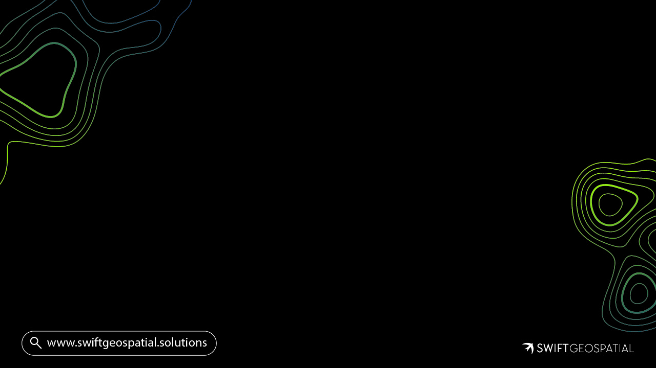
Deforestation & EUDR Risk Assessment
Compiled by
Michael Breetzke
Director & Co-Founder
Swift Geospatial

Slide 2
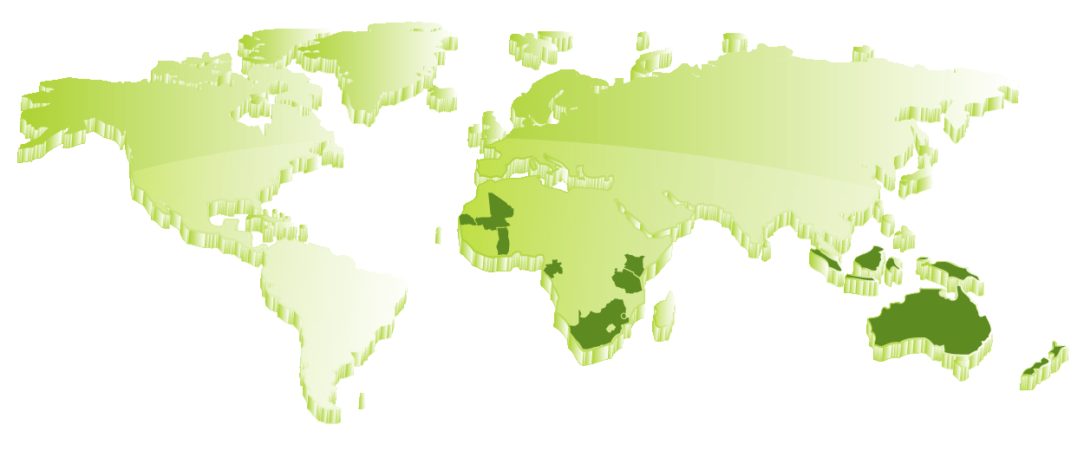

Who is Swift Geospatial
A South African Company with Global Reach

Slide 3
Who is Swift Geospatial
2016
Doors Open
2017
Formed Partnership with ESRI
2018
Formed Partnerships with Satellite Imagery Providers
2019
Desktop Monitoring Analysis
2020
AWS Migration
2022
2021
Automation
Geospatial Platform Development
2023
Measurement, Reporting & Verification (MRV)
2024
AI/ML Research
2025
AI/ML Implementation
2024
2025

Slide 4
Who is Swift Geospatial
04
50cm – 1.2m Radar Imagery
Capella Space
03
3m Optical Imagery
Planet
02
30cm Optical Imagery
Maxar
01
Enterprise Server
ESRI
00
Open Data Sources
Open Data

Slide 5
Who is Swift Geospatial
Commercial Forestry
ESG
Encroachment
Mining
Agriculture
EUDR & Deforestation

Slide 6
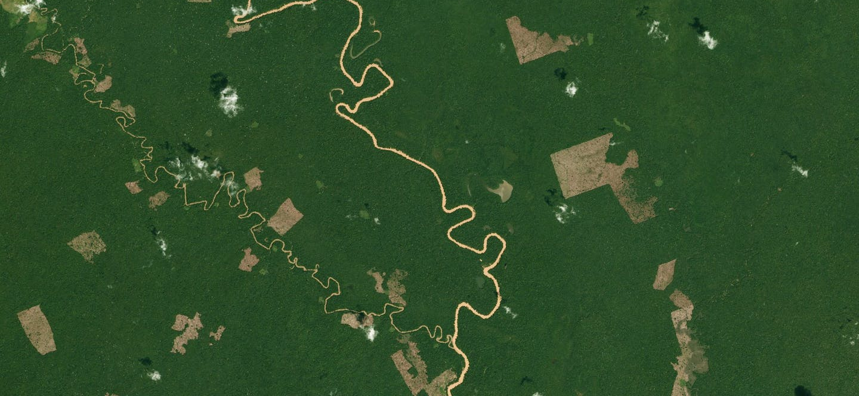
Project - Requirement
Deforestation Risk Assessment
Identify deforestation risk dating as far back as 2004
  Assisting companies with Corporate Sustainability Reporting Directive (CSRD)
Year of field transition
Overall deforestation overview
EUDR Risk Assessment
Identify EUDR risk date as of December 2020
  Assisting companies with EUDR compliance through farm level risk analysis
Field level only
Provide decision support, reporting, recommendations and monitoring

Slide 7
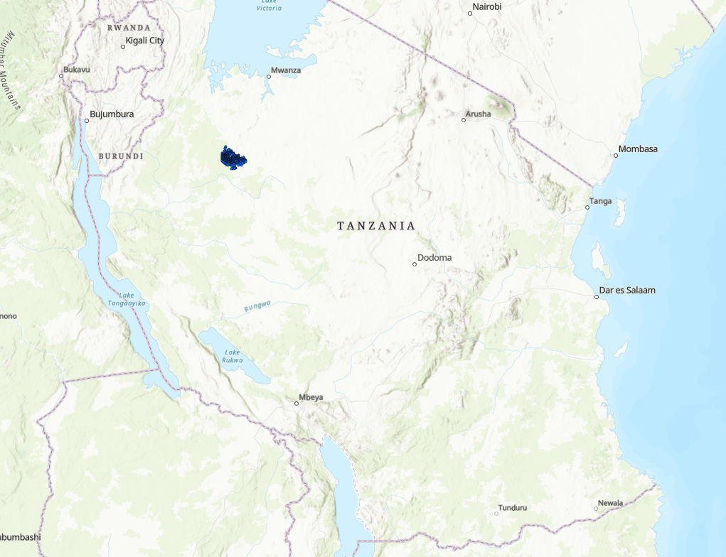
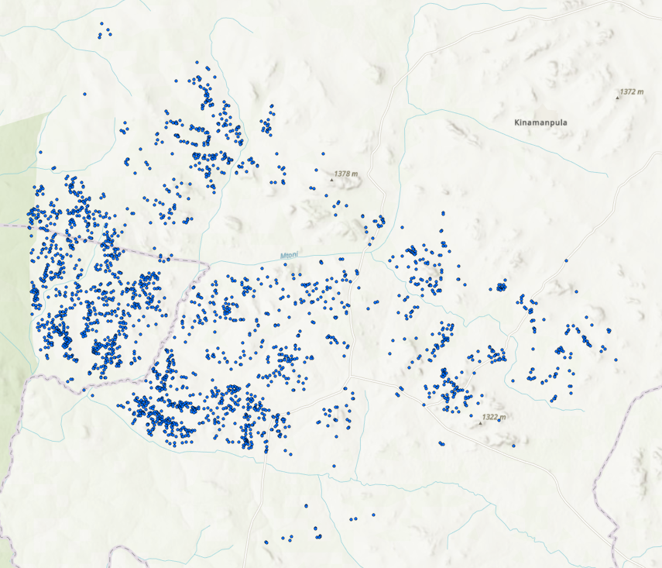
Phase 1 – Location

Slide 8
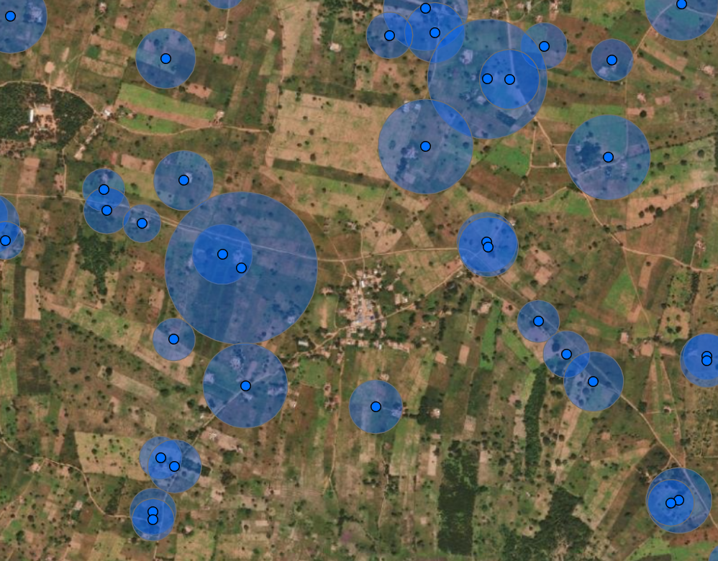
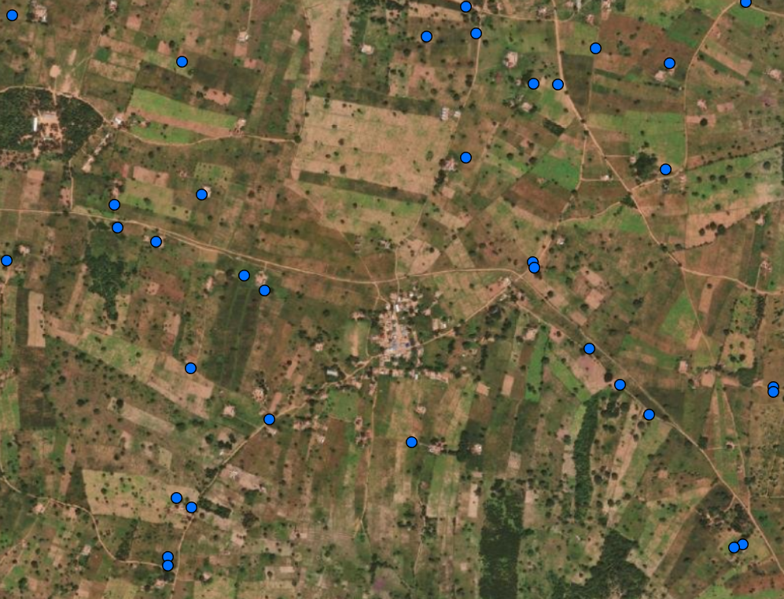
Phase 1 - Location
Location
2 757 fields received (points)
Challenges
Points with farm size attribute only
  Fields not mapped
  Estimated size
  Location position errors
  Overlaps
Recommendation
Digitize field boundaries

Slide 9

Phase 2 - Analysis
The base land cover (LC) is the modelled landscape from multi-seasonal imagery. The 2019 data is the reference landscape generated from 20m Sentinel-2 imagery, and woody canopy height corrected with the 2019 GLAD data. The 2019 reference data is modelled in Google Earth Engine (GEE) using Machine Learning (ML) rules we set up for globally scalable landscape interpretations.
The 2024 Land Cover has also been generated using multi-seasonal Sentinel-2 imagery, with the same GEE-ML rules and models.
Therefore, yearly land cover maps can be generated as far back as 1994 onwards.
Decision was made to generate our own Landcover maps instead of using open source data.
Reasons being:
Sporadic landcover maps available
Consistency
Regional areas of interest
Custom classes per region

Slide 10
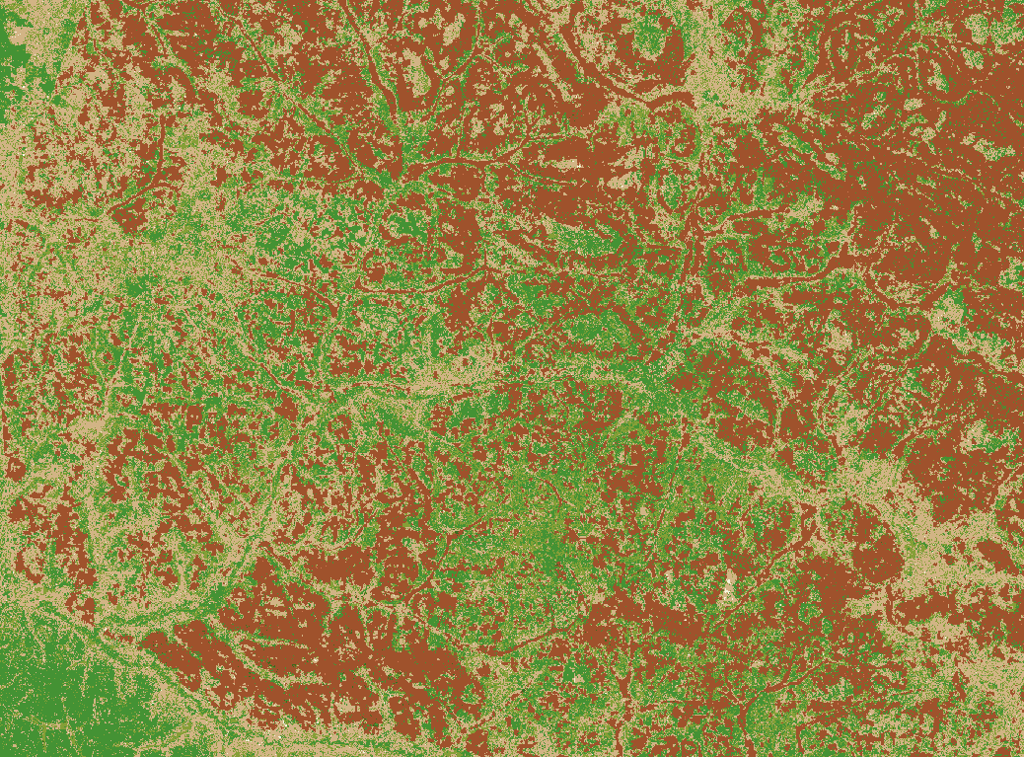
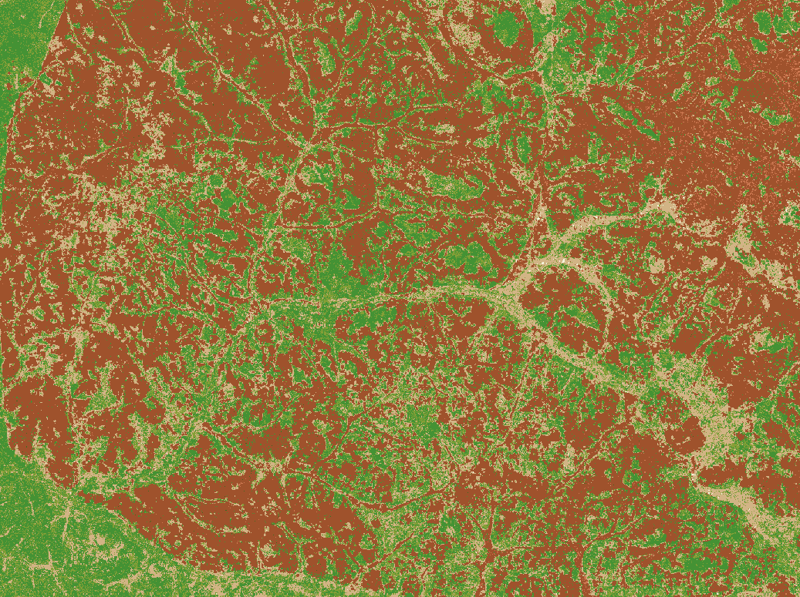
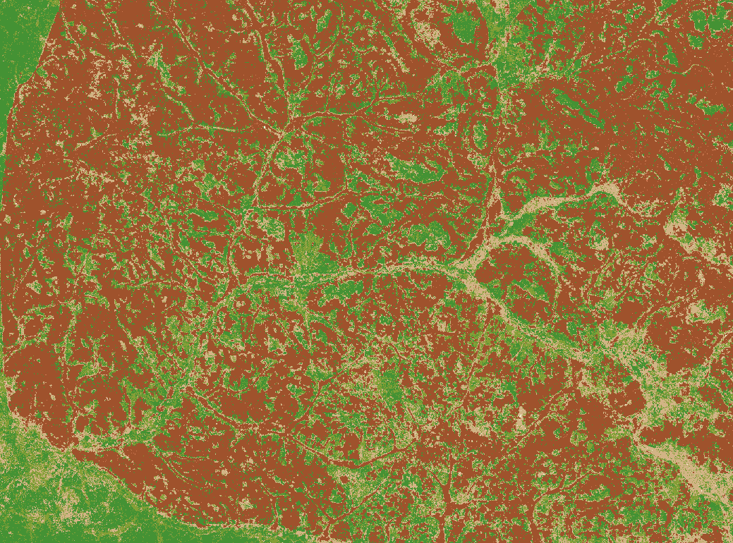
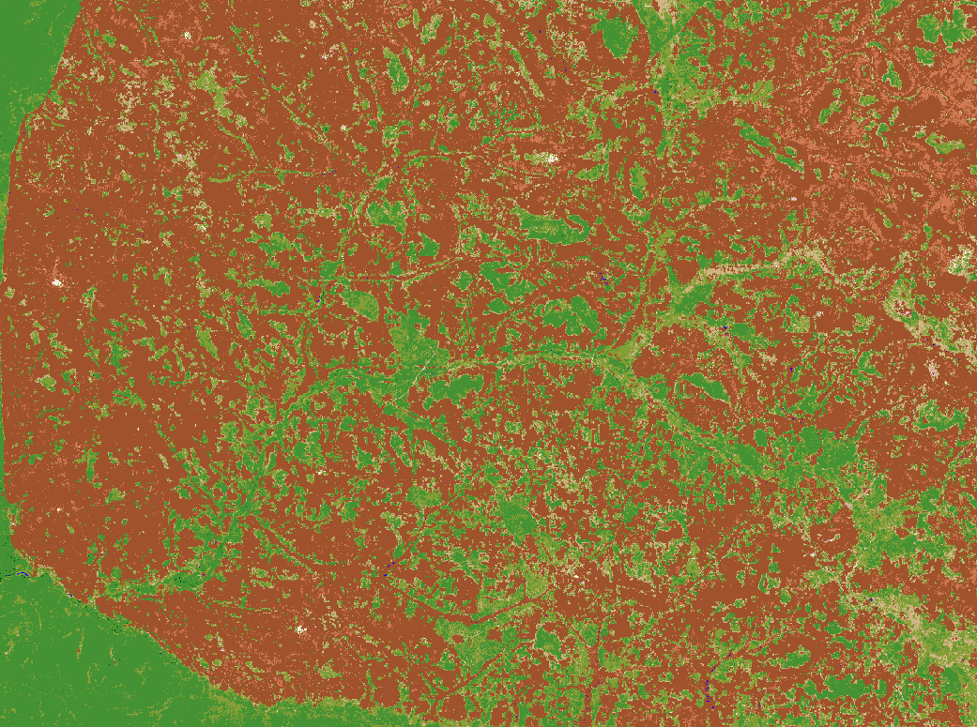
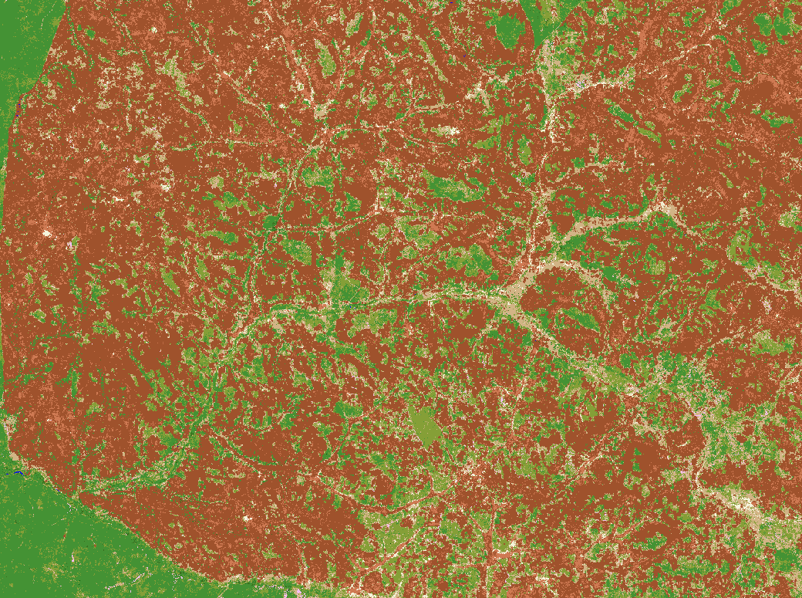
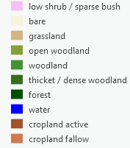
Phase 2 - Analysis
2004
2010
2015
2019
2024

Slide 11
Phase 2 - Analysis
2004
2024
Woody Cover to Agriculture

Slide 12
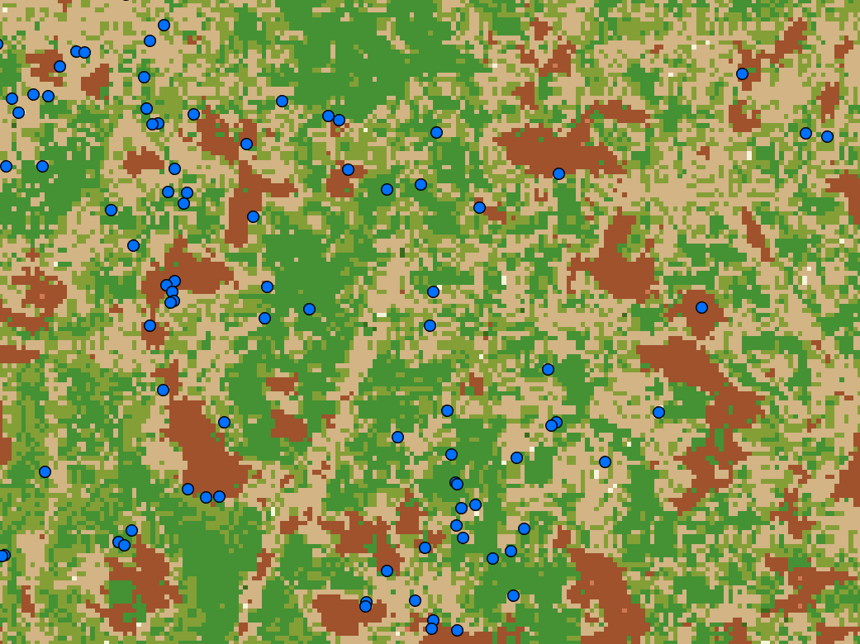
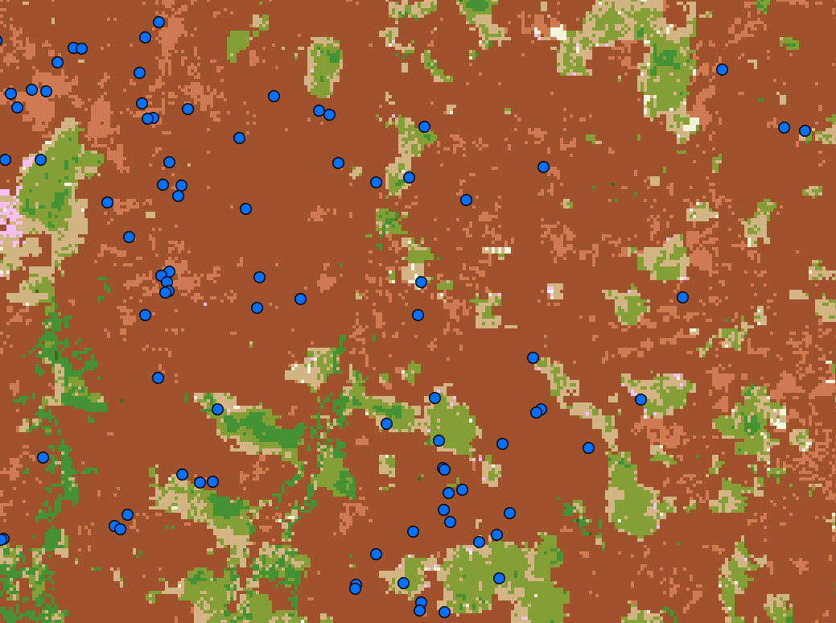
Phase 2 - Analysis
2004
2024
Adding the field locations and running statistics to provide farm level insights

Slide 13
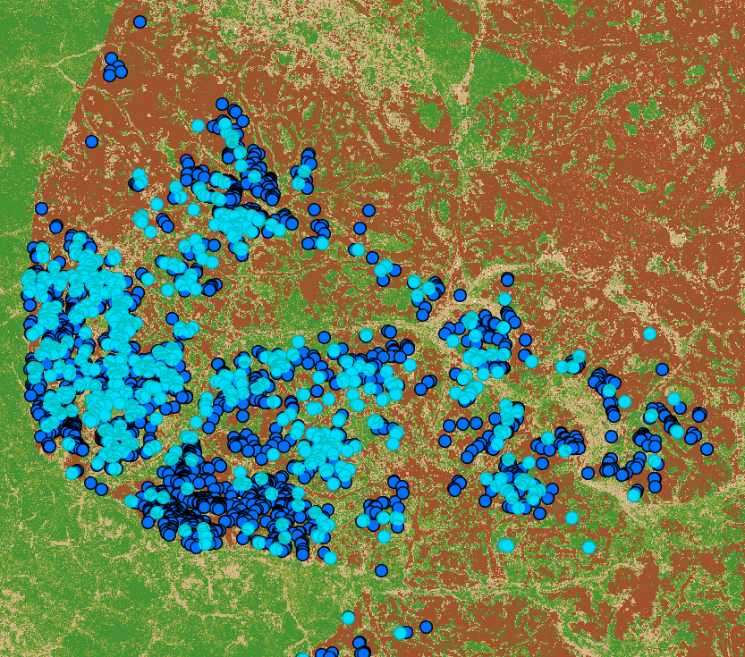
Phase 2a – Analysis – Deforestation Free Sourcing
Project Objectives
Deforestation identification in relation to their tobacco leaf operations.
  Dating back to 2004
593 fields have been identified that fall on Forest/Woodland in 2004.

Slide 14
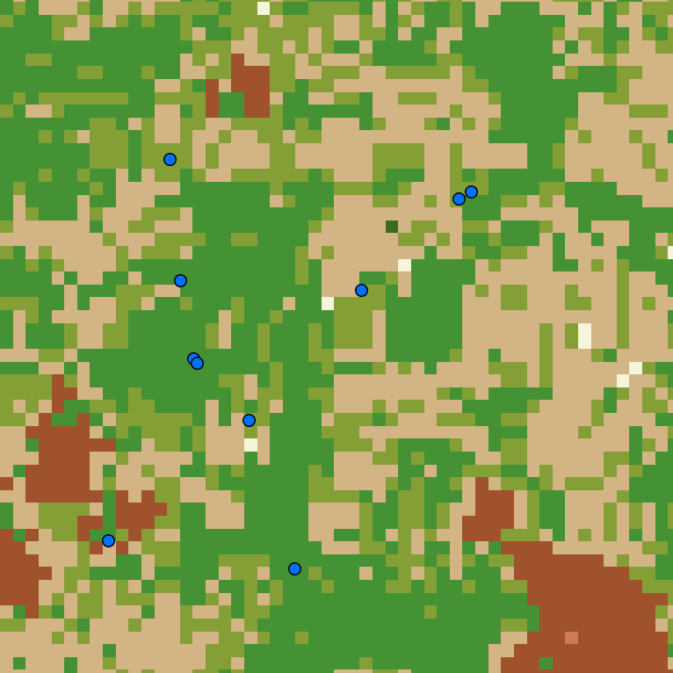
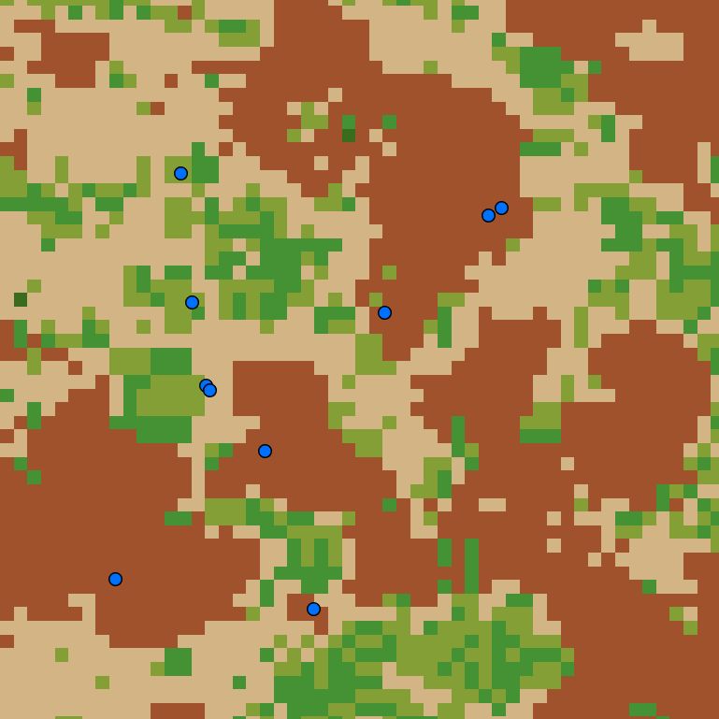
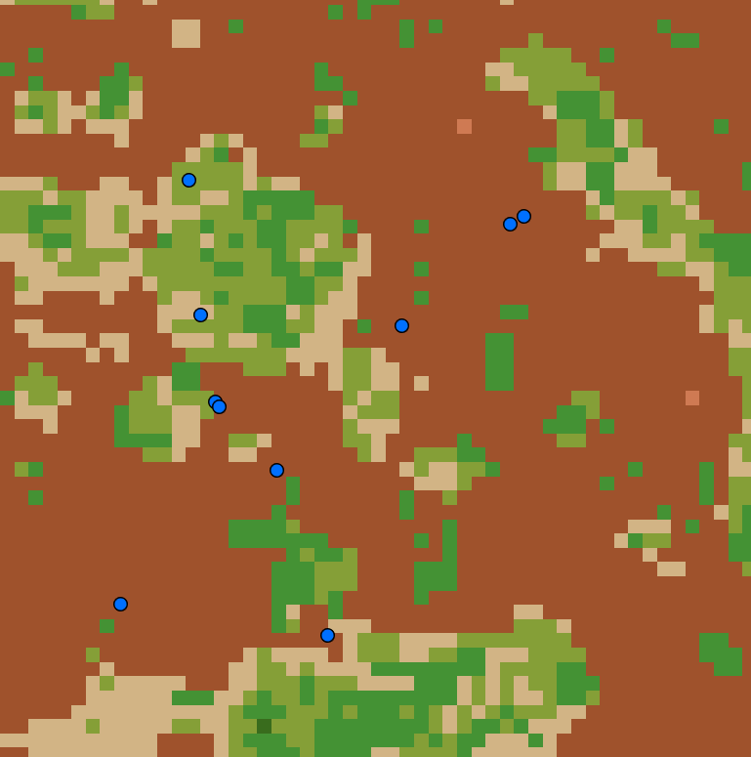
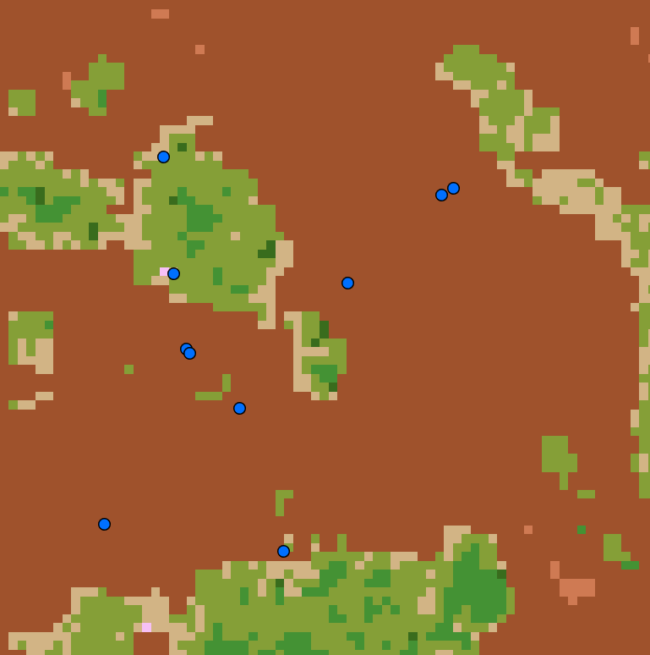
Phase 2a – Analysis – Deforestation Free Sourcing
2004
2010
2015
2019
We identified for the client at farm level, at which time period the farm transitioned from woodland to agriculture.
This analysis can be run yearly if required.

Slide 15
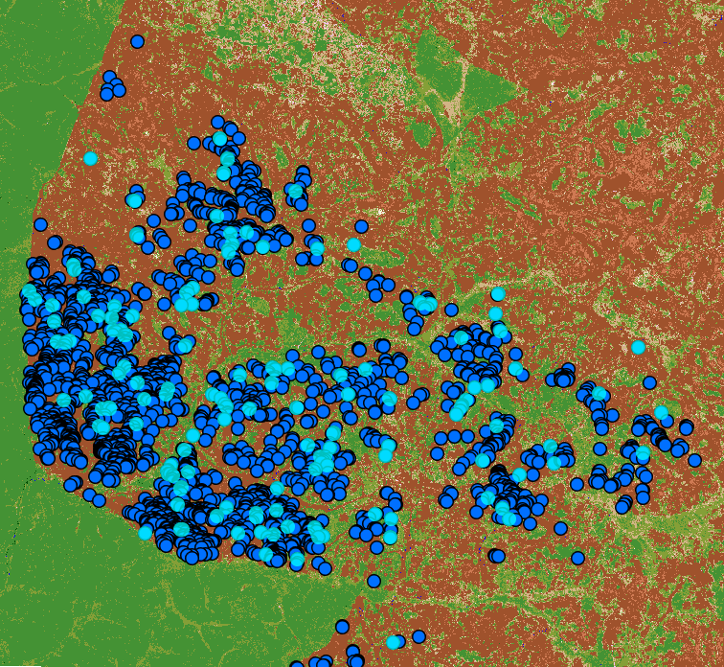
Phase 2b – Analysis – EUDR Risk Assessment
Project Objectives
EUDR risk assessment
  Identification of farmers/farms for further investigation
171 Fields have been flagged for further EUDR risk classification

Slide 16
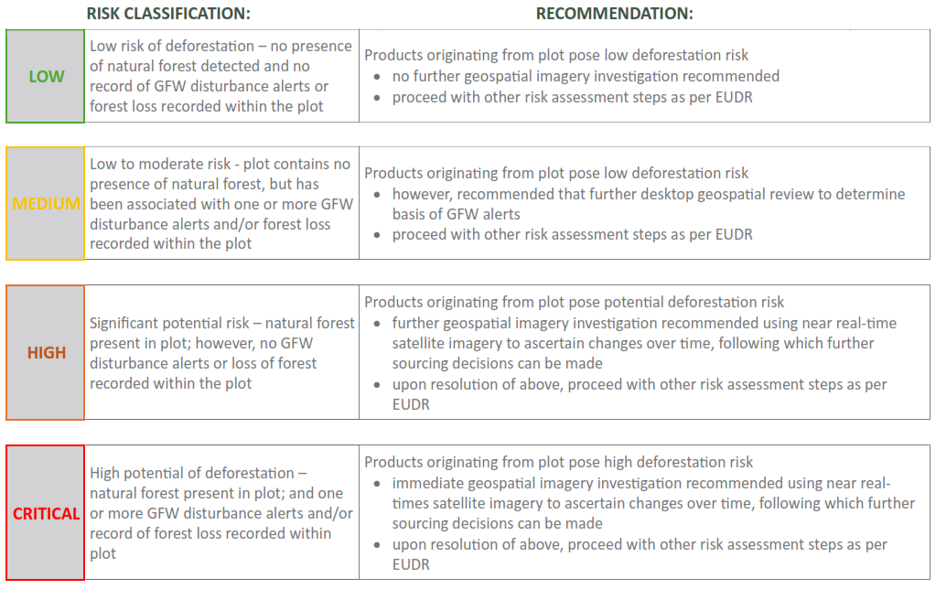
Phase 2b – Analysis – EUDR Risk Assessment
Compliant
Non-Compliant

Slide 17
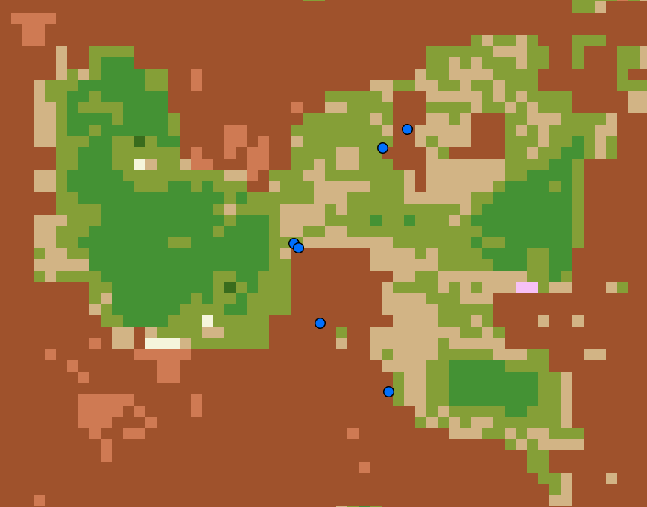
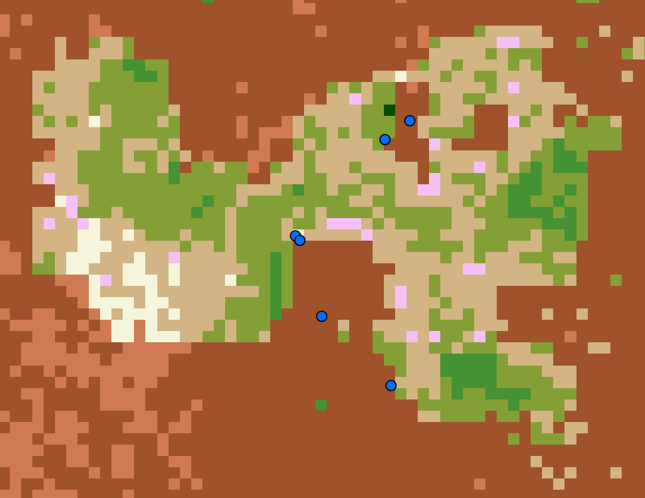
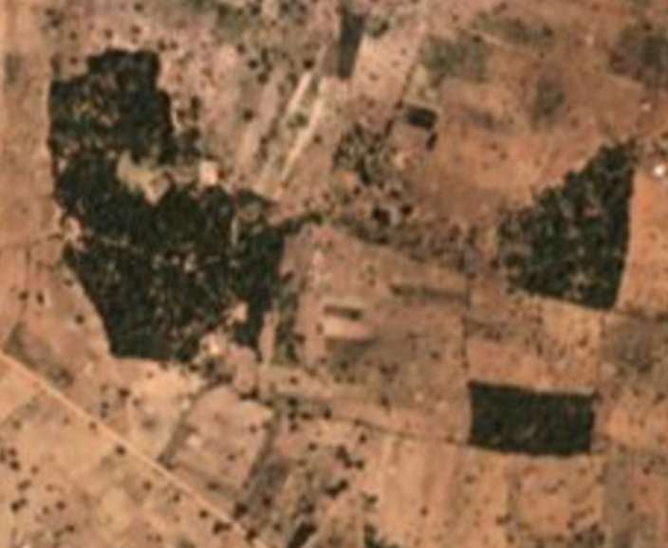
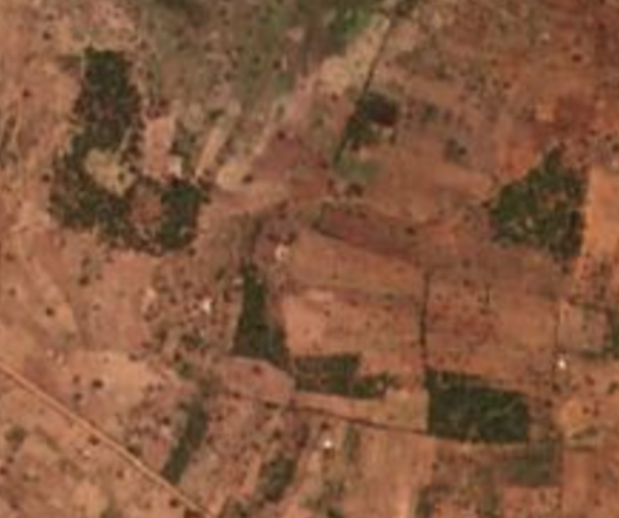
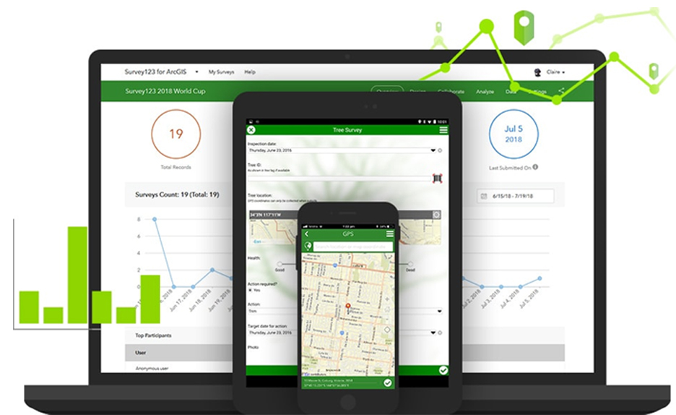
Phase 3 – Verification of Non-Compliant Farms
Desktop Verification
PlanetScope Imagery
  3m Resolution
  8-band
  Daily imagery collection
In-Field Verification
Custom built offline mobile survey
2020
2024
PlanetScope 3m Imagery
(Nov 2020)
PlanetScope 3m Imagery
(Nov 2024)

Slide 18
Thank you
Michael Breetzke
Swift Geospatial
michael@swiftgeospatial.solutions
www.swiftgeospatial.soltions

